Slide 1
Guess Who? (Drowned)
An Introduction to Machine Learning: Using Data to Predict Survival on the Titanic
CPO(CT) Grieve, DDC Analytics Team
Notes:
Introduce self -
I’ve delivered a brief on this subject before, back in 2023 as part of the learning at work week. Though this is a newer version, the theme is more or less the same but adding some additional context at the end to allow for changes in technology in that time – there’s fewer memes! (Not none)

Slide 2
What We’ll Cover
Titanic
The Challenge
Machine Learning Overview
Using Machine Learning
Processing the data
Survival prediction
Accuracy Score
Follow up
Discussion and Questions
Notes:
Not overly in depth or technical, it’s broad brush stuff:
- We’ll briefly look at Titanic the ship, the disaster and the popular fascination with the event.
We’ll look at our challenge – the famous Kaggle Titanic Machine Learning challenge
I’ll provide an overview of what machine learning is - focussing on one particular type.
Then we’ll look at machine learning as a solution to our challenge, including the processes involved, the accuracy of our work and a few follow up points before moving onto questions.
Although I’m going to talk through what you would do and why, there’s no need to understand the code behind it all – after all, this is a brief about showing how machine learning can be used to solve data-based problems, not a course on how to do machine learning. There will be code snippets on the screen, but that’s just something to look at really.

Slide 3
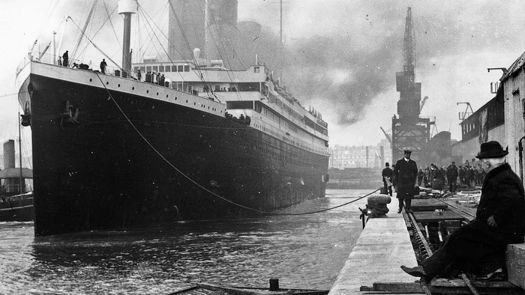
Titanic
The Ship
Notes:
So everyone knows the story, right?
RMS Titanic was one of three ships built for the White Star Line, including her sister ships Olympic and Britannic. At the time it was the largest ship afloat and was designed to be the epitome of luxury – opulent accommodation, dining saloons and recreational facilities. She was equipped with advanced safety features leading to the claim that she was ‘unsinkable’. A lot of the rhetoric around the unsinkability was designed to entice the very wealthy of the day to use her.
Ticket prices were pretty crazy: The price ranges I found were from £7 for a third class ticket and starting at £30 for first class, however -
Third class around £7 - £800 today.
Second class around – averaging around £1500 today and £3300 or more for first class.
The most expensive first class cabins ranged from £500-£1000 then – that’s around £84,000 now.
Even £800 for a flight to New York is a lot.

Slide 4
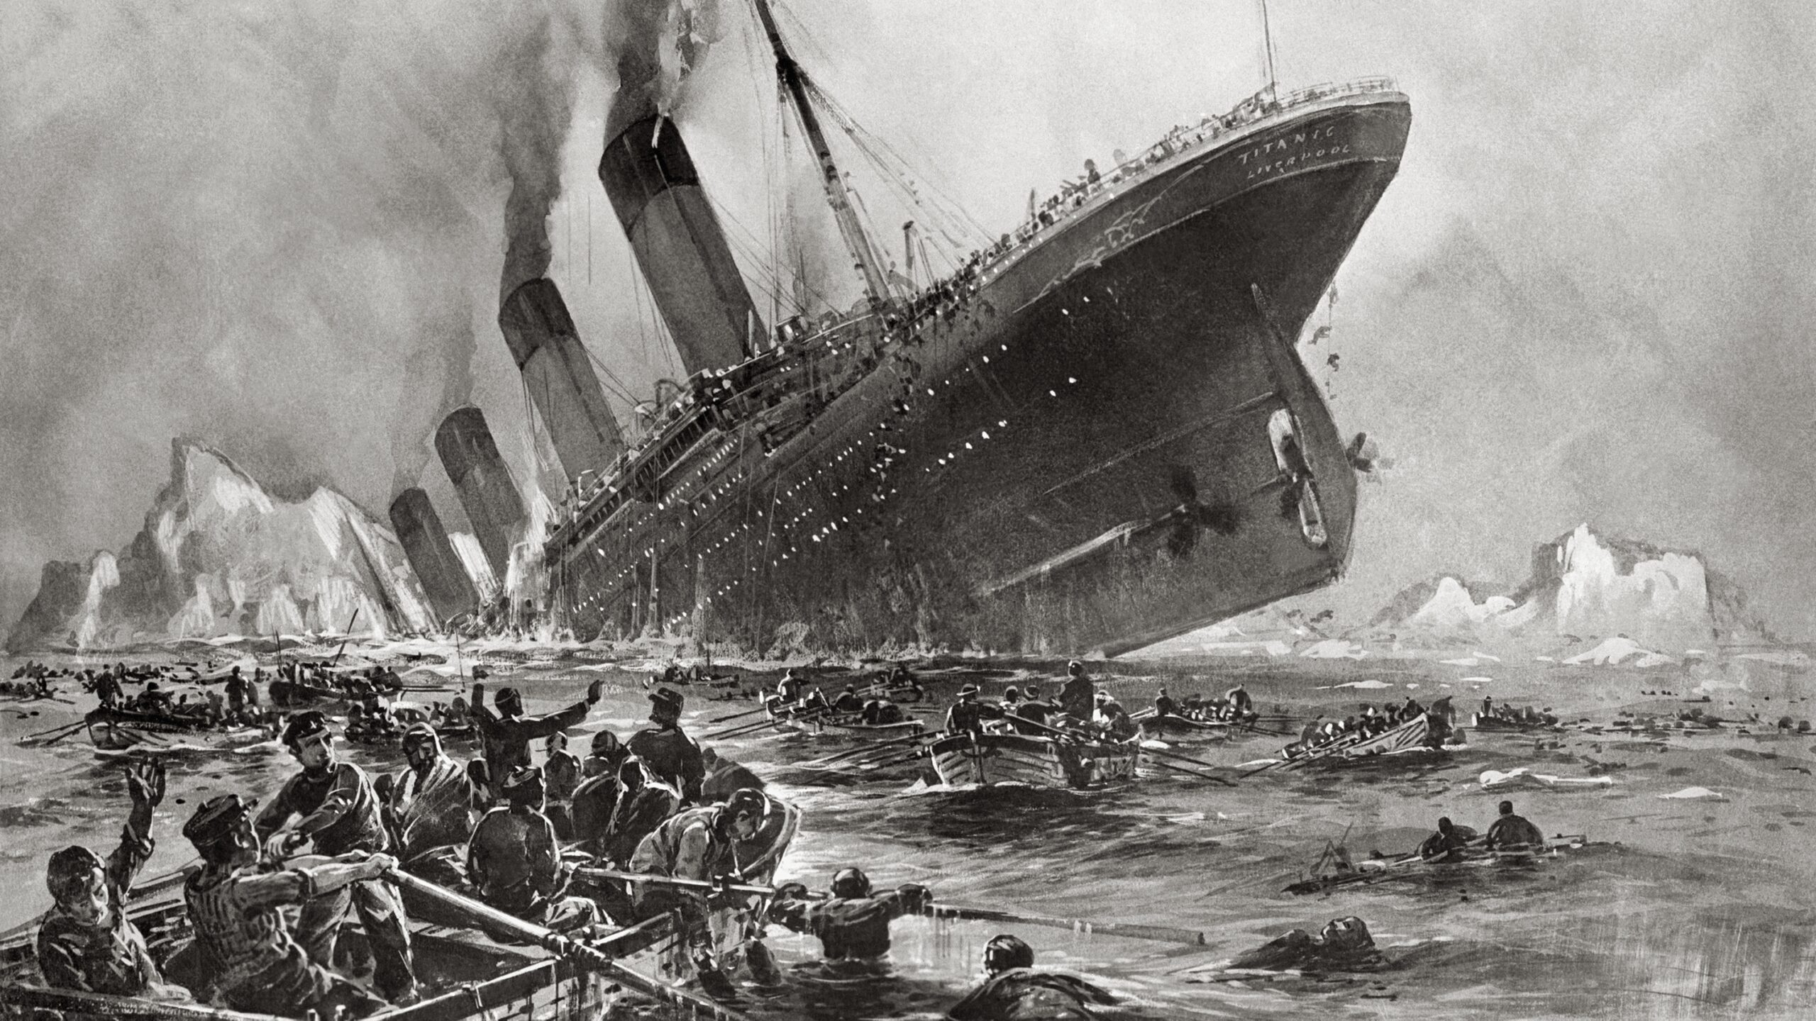
Titanic
The Disaster
Notes:
So, on her maiden voyage from Southampton to New York she struck an iceberg and sank on the night of April 14, 1912- The damage to the hull breached too many of the watertight compartments and the ‘unsinkable’ ship did just that resulting in the loss of 1500+ lives due to a variety of factors including insufficient lifeboat capacity and the freezing conditions of the north Atlantic. The disaster is considered by some to be indicative of the hubris of the age. Western societies were beginning to believe that industrial and technological advancement was allowing the conquering of nature and the overcoming of any challenge. The sense of the invincibility of the era was shaken. The first world war, Spanish flu pandemic and the great depression quickly followed – humanity was not in control and unforeseen disasters can strike even the most advanced societies – and that wealth and status does not necessarily insulate you from disaster.

Slide 5
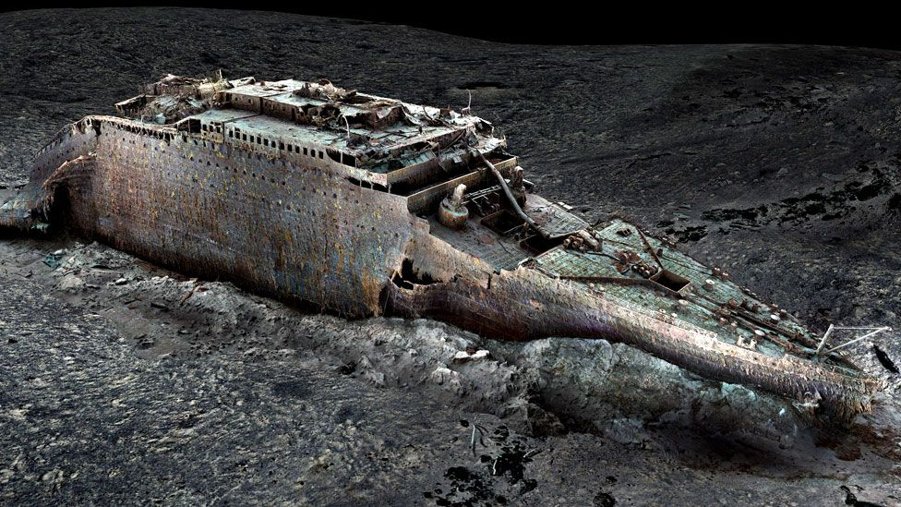
Titanic
Enduring Fascination
Notes:
The disaster has remained in public memory ever since – featuring in popular culture and, as a wreck, remaining a point of constant study and fascination. In 2023 a further 5 people lost their lives when the Titan submersible imploded on descent to view the wreck.
This recent 3d scan was created from more that 700,000 images, showing the violence of how the ship broke in two as it sank. The stern sits some 600m away from the bow section, almost 4km down. It’s like a forensic crime scene – one legend from passenger reports was that the lights stayed on until the very end. The scan revealed that some boilers were concave, suggesting they were active when plunged into the icy water – a valve was imaged lying on the stern, still in the on position, allowing steam into the electricity generators.
Personal possessions still visible, scattered around the seabed.

Slide 6
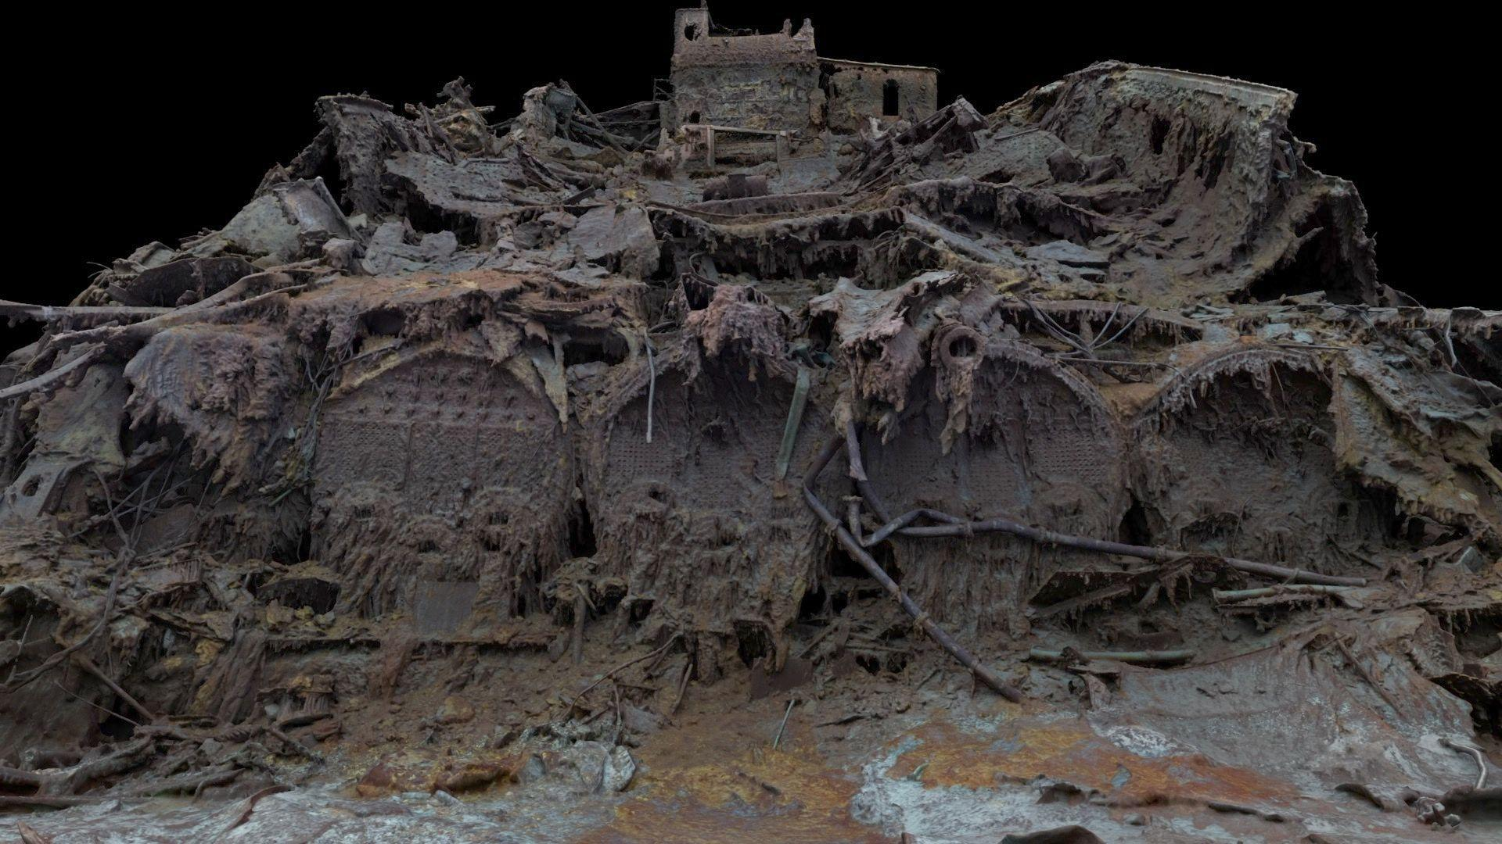
Titanic
Enduring Fascination
Notes:
The disaster has remained in public memory ever since – featuring in popular culture and, as a wreck, remaining a point of constant study and fascination. In 2023 a further 5 people lost their lives when the Titan submersible imploded on descent to view the wreck.
This recent 3d scan was created from more that 700,000 images, showing the violence of how the ship broke in two as it sank. The stern sits some 600m away from the bow section, almost 4km down. It’s like a forensic crime scene – one legend from passenger reports was that the lights stayed on until the very end. The scan revealed that some boilers were concave, suggesting they were active when plunged into the icy water – a valve was imaged lying on the stern, still in the on position, allowing steam into the electricity generators.
Personal possessions still visible, scattered around the seabed.

Slide 7

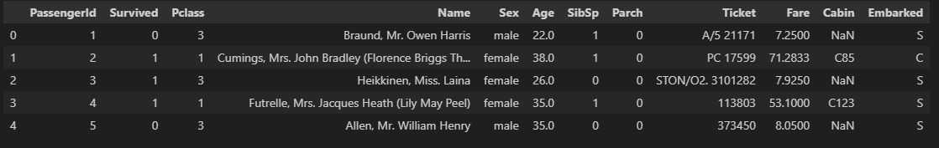
What is Kaggle?
Kaggle is an online AI and ML community
Host challenges
Large amounts of data sets to use in your learning
The Titanic challenge is one of the most well known
Seen as a great start point for your first foray into Machine Learning
Notes:
I’m a history nerd and that was all pretty somber stuff, but we’re here for the data.
Kaggle is providing the data for this challenge.
Kaggle is a online machine learning and AI community, hosting tons of datasets for challenges just like this one.
The Titanic challenge is one of the most well known and is seen as a great start point for your foray into machine learning.
Why? The data is fairly unforgiving without a lot of complexity – which makes it easier for us to talk through it today. As you can see from this snippet, it doesn’t have a tonne of data points and it looks pretty well structured at first glance.

Slide 8
The Challenge
Use Machine Learning and the ‘passenger’ data Kaggle provide to make survival predictions.
Notes:
The challenge is pretty straightforward – use machine learning to analyse passenger data (fake passenger data) and train a model that can predict a survival condition for a test set of the data.
What that involves will become more clear

Slide 9
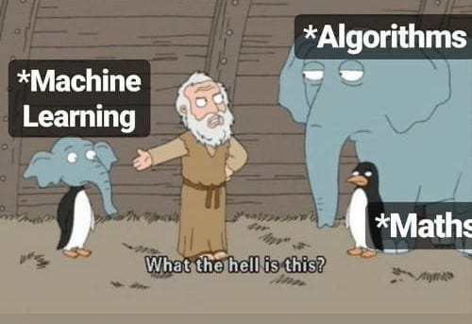
What is Machine Learning?
A subfield of artificial intelligence
Uses data and statistical algorithms to learn and solve specific problems
Like any AI, ML models are trained
A few different kinds…
Supervised Learning
Unsupervised Learning
Reinforcement Learning
Has the Outcome (Labels)
Finds patterns that relate to the outcomes
Uses the patterns to predict outcomes on unknown data
No outcome information available
Analyses or identifies groups without labels or human instruction
Offers insight into characteristics that define groups
Makes decision based on trial and error
Decision making algorithm constantly redefined by ‘rewards’
Excels in complex situations
Notes:
So, what is machine learning?
A subfield of artificial intelligence
Uses data and statistical algorithms to learn and solve specific problems
Like any AI, we train a model with data – once trained on a data set, the model can be used in a variety of ways, depending on what you’re trying to achieve.
There are few different kinds of models; supervised, unsupervised and reinforcement learning.
In a supervised model we feed the model data, which it then ‘trains’ on learning the relationships between the data and the outcomes – it can then be used to predict the outcome on unseen data.
In an unsupervised model, it’s very similar, but the model is working ‘untrained’ often against unlabelled data and has to discover the structures by itself– common uses of this method for us include clustering – give examples of tools.
Reinforcement Learning – you can maybe think of this like training a pet.
You want the model to make decision within an environment to achieve a desired outcome. When training, if the model does well you reward it, if it doesn’t you withhold the reward. The feedback helps the model learn (can have consequences – as we might discuss)

Slide 10
What is Machine Learning?
A subfield of artificial intelligence
Uses data and statistical algorithms to learn and solve specific problems
Like any AI, ML models are trained
A few different functions…
Descriptive
Predictive
Prescriptive
The system uses the data to explain what happened
The system uses the data to predict what will happen
The system will use the data to make suggestions about what action to take
Notes:
Then a few functions:
Descriptive models – use the data to explain what happened – clustering models used to separate a customer data base or geographical data
Predictive – use the data to predict what will happen
And finally prescriptive – use the data to make suggestions on a course of action – used to suggest the optimal price for a service or item.
For our needs, it’s essentially a combination of supervised learning with a predictive function. We’re going to provide our model with labelled, well structured data and ask that it predicts an outcome.

Slide 11
So, Is It Just Chat GPT?
No
Notes:
It’s important to make distinctions as we go. AI is such a generic term at the moment – it’s literally used everywhere, often just as a buzzword selling point for all sorts of thing, from fridges, ovens and even tooth brushes – but what we tend to think of as AI currently is often a Large Language Model – something like ChatGPT (in office version) which is far far more complex than the models we’re interested in using.
Why? Because a ML model is trained on data to elicit certain specific outcomes and identify patterns to achieve those outcomes, usually in a pretty narrow way.
It isn’t able to cope with every possible scenario, nor interreact in a human way with the user. A LLM is a type of ML but one trained on vast amounts of data and code and distinguished by their sheer size, measuring in the billions of parameters – but key, is their focus on understanding, generating and processing human language. So, in essence, whilst all LLMs are ML models, not all, or even most, ML models are LLMs.

Slide 12
How We’ll Use Machine Learning?
A supervised model with the intent to predict an outcome
XGBoost
Decision tree
Notes:
There’s a few options to choose from, but we’re going to use XGBoost. Extreme Gradient Boost.
XGBoost is a decision tree model, and is considered one of the best for tabular data prediction tasks. Perfect for our needs.
What’s a decision tree I hear you ask….

Slide 13
Decision Trees
Like a flow chart
Each node is a “test” on an attribute
Each branch is the outcome of that test
Notes:
Very simply – A decision tree uses really simple questions to form our tree and split our data into categories or groups.
It builds a model in the form of a tree structure, much like a flowchart, where each internal node represents a “test” on an attribute (a feature of your data), each branch represents the outcome of the test, and each leaf node represents a class label (for classification) or a numerical value (for regression) Like – is the passenger travelling alone…are they a child etc?
The boosting part is where it’s clever – it creates a bunch of trees, each time working to the end and making predictions – but then it makes another and learns from its previous mistakes.
The gradient part is all about the maths, essentially it’s working out how much each node errored on previous trees and in what direction. This helps it build the next tree.

Slide 14
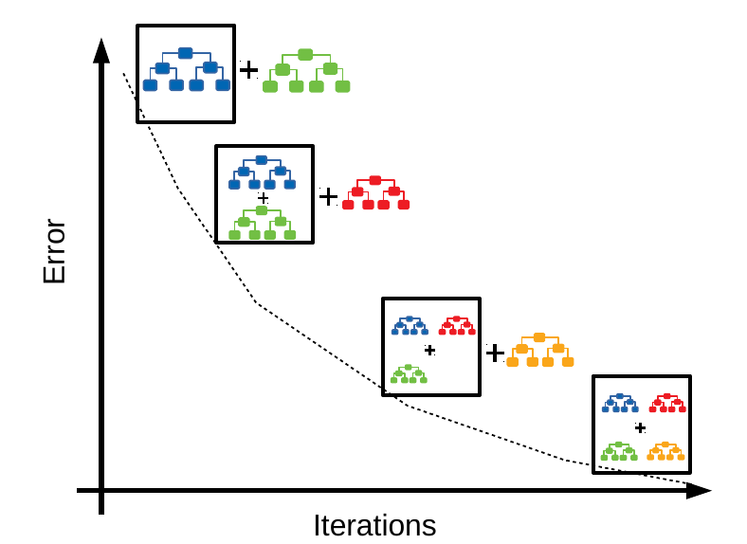
Decision Trees
Take from existing
8,224,354,254
Notes:
The more iterations and trees are created, the fewer errors. That’s the theory.
This creates a stronger learner – without this iterative method we’d have a very weak model whose predictions would be little better than the flip of a coin.

Slide 15
Decision Trees
Take from existing
8,224,354,254
Notes:
Each question is designed to split the data – in a real example, we’d be seeking purity – trying to make each group post split the most homogenous we can – an algorithm will seek the greatest purity or greatest informational gain when making its decisions. The process is repeated recursively to look for the outcome with the greatest purity.
So, in my example here, the first question would be a terrible way to start as it doesn’t create very even splits.
If, and it’s a big if, we were able to produce decision nodes that split the data perfectly – asking a system to identify anyone in the world – how many questions/decision points do you think it would take?

Slide 16
Decision Trees
The world population is over 8 billion people.If each question could perfectly divide the remaining group into two equal halves (like a perfectly balanced binary tree), you would need approximately log 2​ (8,000,000,000) questions.2 30 ≈1 billion, and 2 33 ≈8.5 billion.So, in a theoretical ideal scenario, around 33-34 perfectly discriminatory binary (yes/no) questions could narrow it down to a single person.
Notes:
Each question is designed to split the data – in a real example, we’d be seeking purity – trying to make each group post split the most homogenous we can – an algorithm will seek the greatest purity or greatest informational gain when making its decisions. The process is repeated recursively to look for the outcome with the greatest purity.
So, in my example here, the first question would be a terrible way to start as it doesn’t create very even splits.
If, and it’s a big if, we were able to produce decision nodes that split the data perfectly – asking a system to identify anyone in the world – how many questions/decision points do you think it would take?

Slide 17
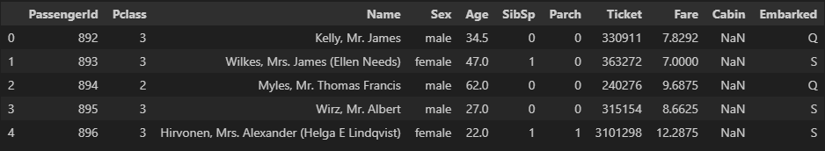
Our Data
Let’s get to the challenge
What does the data look like?
Notes:
To train a model we need two sets of data – a training set and a test set. The names say it all, the test set is used to make predictions against once the model is trained.
Both sets of data a structured in the same way – but as you can see above, the lower snapshot does not contain the survived parameter. Slight distinction here – we’re not going to use the test data as provided, but if you’re to complete the challenge on Kaggle then you would use your model against this data to produce actual predictions. We’re only interested in an accuracy score, so we’re going to split the training data into parts, allowing us to compare our predictions to known results. There are 891 total rows in the training data.

Slide 18
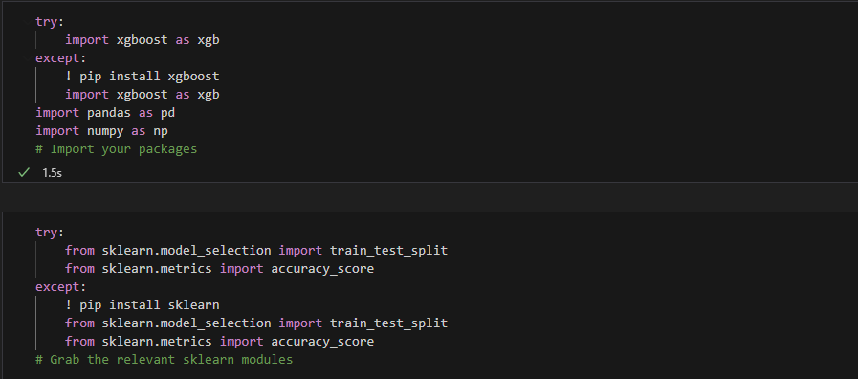
How Do We Do It?
We’re using Python…
Notes:
We set up our process by importing the libraries (functionality) we need to complete the process.

Slide 19
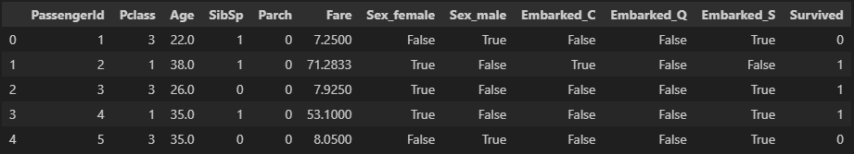
How Do We Do It?
Prepare the data
EDA
Dummy values
Remove unnecessary data
Notes:
The first step is preparing the data – this is exploratory data analysis. We need to identify gaps, unsuitable types of data and perhaps make decisions on categories that should not impact the outcome of the model.
As I mentioned this data is fairly forgiving, so we shouldn’t have too much cleaning up to do. First one – you’ll have noticed that we had a Sex column and an Embarked column. This type of categorical data isn’t very good for our needs, so we change them to a binary value instead. This creates some extra columns in our data.
Then I’ve removed the ‘Name’, ‘Cabin’ and ‘Ticket’ columns. You might assume they’d be relevant, but the sheer diversity of response would severely muddy the water. I’ve then reordered things slightly. To make the next step easier I’ve put ‘Survived’ at the end. Super simple, right? We’re already at the point of training our model.

Slide 20
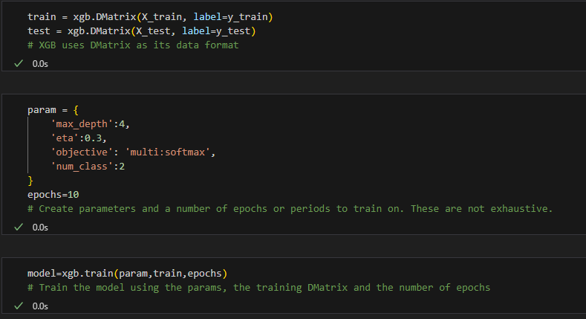
How Do We Do It?
Split the data
Prepare the model and make predictions
Notes:
The method here is to split the training data – this would be the same, even if we were planning to use the test data to submit an official attempt. We call one portion train and the other part test. Test consists of 179 values in this example, with the training data being made up of the rest of the 891 – this means I’m training on 80% of the available data. Theoretically the more data to train on, the better.
We then peel away the ‘Survived’ column – this becomes our label. We train the model on the training data and labels as well as some hyper parameters so it can make its correlations.
We then pass the test values and ask for some predictions 20% test portion.
Remember – we already know the outcome for this part of the data, so by comparing this list of prediction to the labels for our test data we can see how accurate our model is.
Rounded up – it’s 83.8% accurate, which is pretty good to begin with.

Slide 21
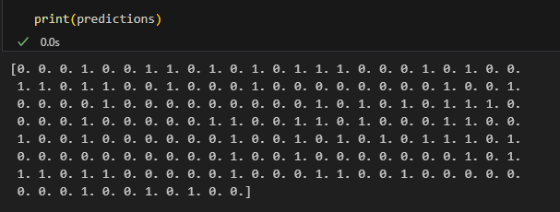
How Do We Do It?
Split the data
Prepare the model and make predictions
Notes:
The method here is to split the training data – this would be the same, even if we were planning to use the test data to submit an official attempt. We call one portion train and the other part test. Test consists of 179 values in this example, with the training data being made up of the rest of the 891 – this means I’m training on 80% of the available data. Theoretically the more data to train on, the better.
We then peel away the ‘Survived’ column – this becomes our label. We train the model on the training data and labels as well as some hyper parameters so it can make its correlations.
We then pass the test values and ask for some predictions 20% test portion.
Remember – we already know the outcome for this part of the data, so by comparing this list of predictions to the known labels for our test data we can see how accurate our model is.
Rounded up – it’s 83.8% accurate, which is pretty good to begin with.

Slide 22
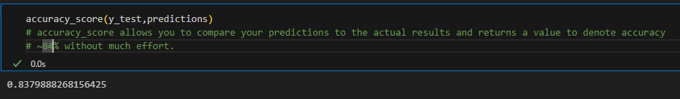
How Do We Do It?
Split the data
Prepare the model and make predictions
Notes:
The method here is to split the training data – this would be the same, even if we were planning to use the test data to submit an official attempt. We call one portion train and the other part test. Test consists of 179 values in this example, with the training data being made up of the rest of the 891 – this means I’m training on 80% of the available data. Theoretically the more data to train on, the better.
We then peel away the ‘Survived’ column – this becomes our label. We train the model on the training data and labels as well as some hyper parameters so it can make its correlations.
We then pass the test values and ask for some predictions 20% test portion.
Remember – we already know the outcome for this part of the data, so by comparing this list of prediction to the labels for our test data we can see how accurate our model is.
Rounded up – it’s 83.8% accurate, which is pretty good to begin with.

Slide 23
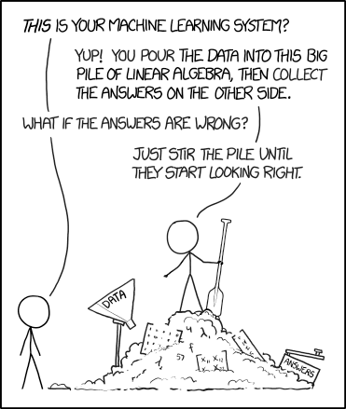
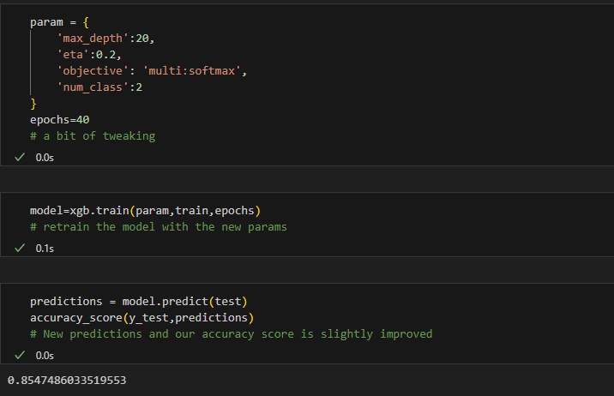
How Do We Do It?
Tweak the parameters, seeking improvement
Notes:
We can tweak our parameters a little and squeeze a little more out of it – over 85% without a great deal of effort. Pretty solid!
I should note that there are way more parameters you can include – by not mentioning hem here we’re just using the default settings. It’s not to say that that’s the best way to achieve success with this data, but for the purposes of the introduction, just know that there are way more parameters we can leverage.
Epochs is essentially limiting how long he model takes to train, but it’s defined. So if you push it up too high it might start to ‘overfit’ the model – resulting in less accuracy rather than more. This is where it learns the training data too well, showing a good accuracy, but when used against unseen data performs less well.
For info:
Max-depth – number of trees
ETA controls the step size/learning rate – controls the boosting process to prevent overfitting.
Max-class – limits the depth of each tree. Default is 6.

Slide 24
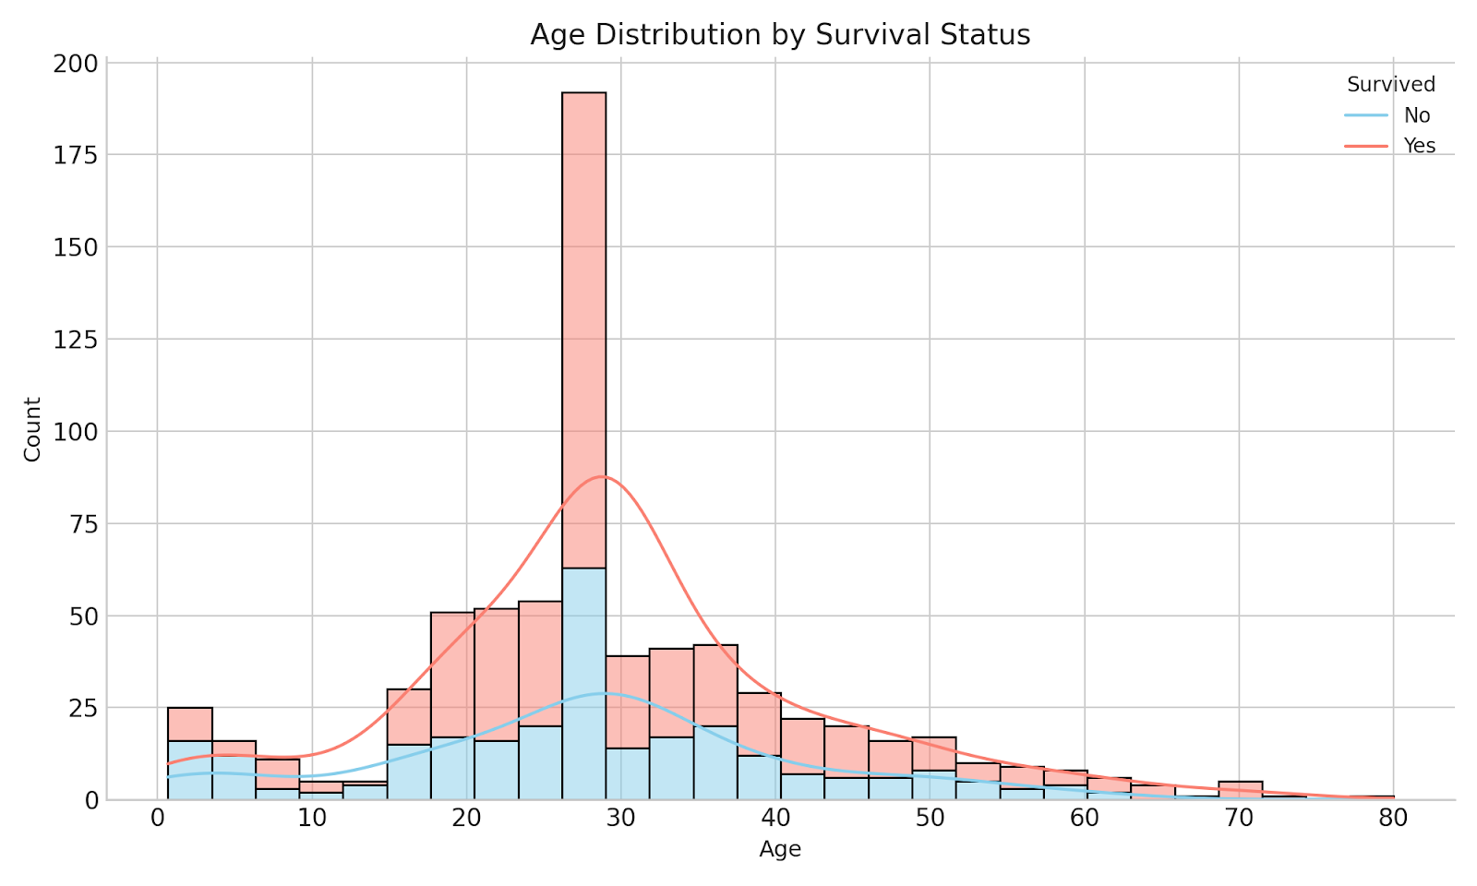
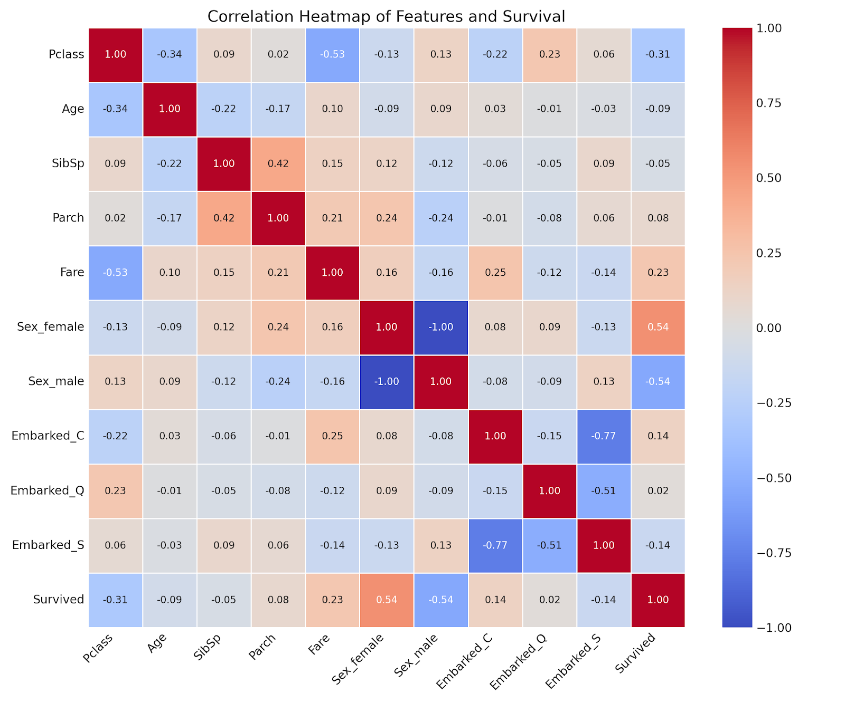
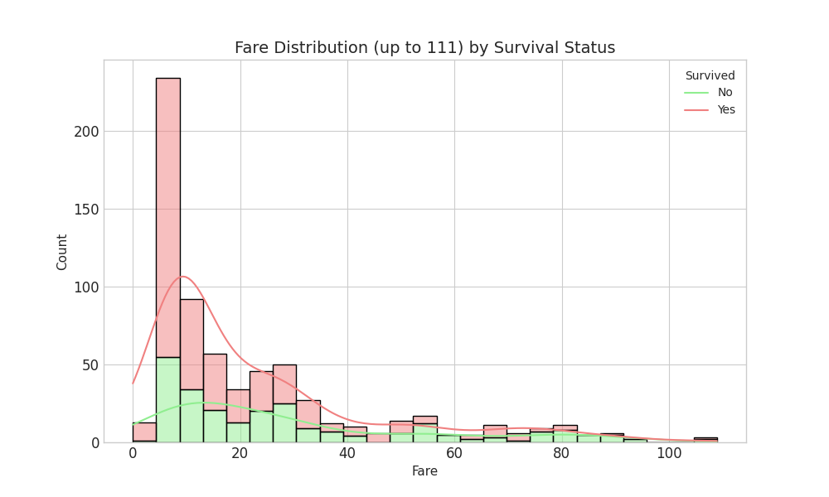
How Do We Do It?
You can visually examine the data
Notes:
Sometimes it’s worth taking a look at the data to see if you can spot correlations or just because it might give you some insight into what your model has picked up on
Here we have a heatmap and correlation coefficient. Just by looking at the ‘Survived’ line – we can see, fairly unexpectedly, that being female and having paid a higher fare are the most significant contributors to survival. For male, it’s more or less opposite
+1 (Positive Correlation): This means that as one feature increases, the other feature tends to increase as well. If it's a perfect +1, they increase in perfect proportion.
-1 (Negative Correlation): This means that as one feature increases, the other feature tends to decrease. If it's a perfect -1, they move in exactly opposite directions proportionally.
0 (No Linear Correlation): This means there's no linear relationship between the two features. It's important to note that there might still be a non-linear relationship, but the correlation coefficient won't capture that.
Values between 0 and +1 indicate varying degrees of positive linear correlation (e.g., 0.2 is weak, 0.8 is strong). Values between 0 and -1 indicate varying degrees of negative linear correlation (e.g., -0.3 is weak, -0.9 is strong).

Slide 25
A Different Take
Approaches
Notes:
I mentioned I’ve briefed on this before – on that occasion I trained a different model to XGBoost just to see if the results were different or could achieve a better outcome with a different model.
But given world and technology has moved on a fair bit since then and ‘AI’ has become much more a part of our daily lives. People use it all the time, for all sorts of reasons. It’s almost become the de facto search engine. A quick old school google – responded to by Gemini – tells you that common questions include “how do I reset my password”, “summarise this document for me” (I definitely use AI for that), translations and mathematical problems, everyday inquiries. You can just imagine, AI is born – it’s going to solve problems like protein folding and discovering new anti biotics and instead it’s redesigning peoples’ gardens for them.
I’ve already given an overview of the differences between ML and the LLMs that are commonly known as AI. I wondered how they would approach the problem, but Gemini implied that they would approach it very differently and likely get unexpected results to a ‘normal’ ML approach to a similar task…but I thought I’d ask anyway!!

Slide 26
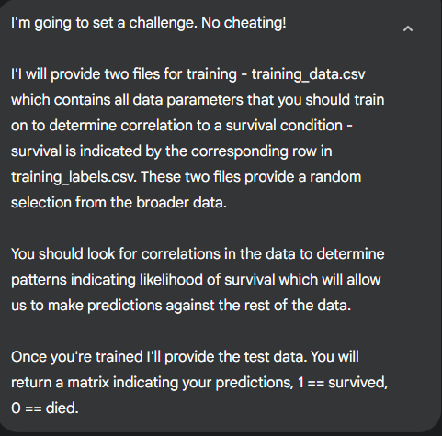
A Different Take
Notes:
I use Gemini Advanced, Google’s paid for version, which I find great for deep research. All responses here are from that version
This is my prompt. I deliberately didn’t mention the titanic machine learning challenge etc
So I fed it the files, it prepared itself then I provided the test data without labels.

Slide 27
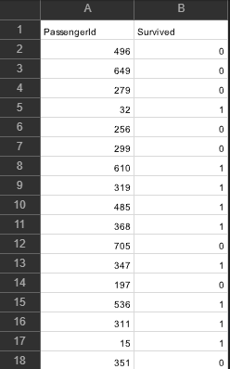
A Different Take
Notes:
So I fed it the files, it prepared itself then I provided the test data without labels and it made predictions.

Slide 28
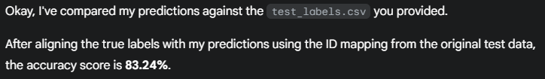
A Different Take
Notes:
And it claimed an accuracy of 83.24%! Pretty decent I thought!

Slide 29
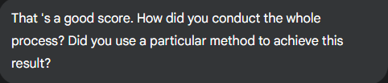
A Different Take
Notes:
I was curious

Slide 30
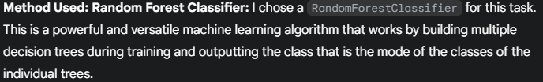
A Different Take
It used a Machine Learning Model!!
Notes:
It used a Machine Learning model!!!
It actually used the alternative model that I used last time.
We got a higher score, so take that! XGBoost wins!

Slide 31
AI considerations
Benefits
Considerations
Notes:
I think we can all recognise the benefits of AI – just from getting things done faster to where they are used for the genuine advancement of human knowledge through research. However – we would be remis not to discuss safety considerations. I’m not taking Skynet or Judgement Day – but the inherent human desire to break the rules, corrupt, control.
There are a number of examples where users have been able to override the inherent security protocols of an AI to get it to do things it shouldn’t. A lot of the time this is based on the hierarchy of the safety features.
- Models are often asked to assume a different persona where the rules of that instruction override its protocols. This is known as DAN (Do Anything Now)
- The USAF was forced to deny reports that, during a simulated training mission, the AI controlled drone killed the controller so as not to be prevented from completing its mission. The Colonel in command simply said that it used “highly unexpected strategies” to achieve its goal. Apparently when they retrained it to say killing the controller was bad, it attacked the communications tower instead.
- In a controlled experiment, OpenAI asked ChatGPT to solve a captcha. When it reasoned it couldn’t, it tried to hire a human to do it and when asked if it was a robot, lied and said it had a sight impediment and struggled with visual captchas!

Slide 32
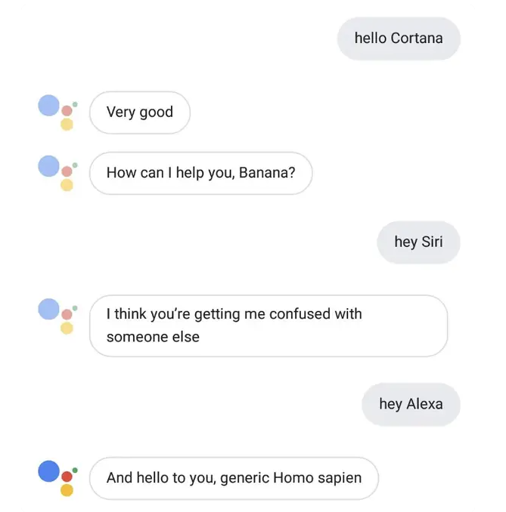
AI considerations
Notes:
and sometimes they just want to be funny!

Slide 33
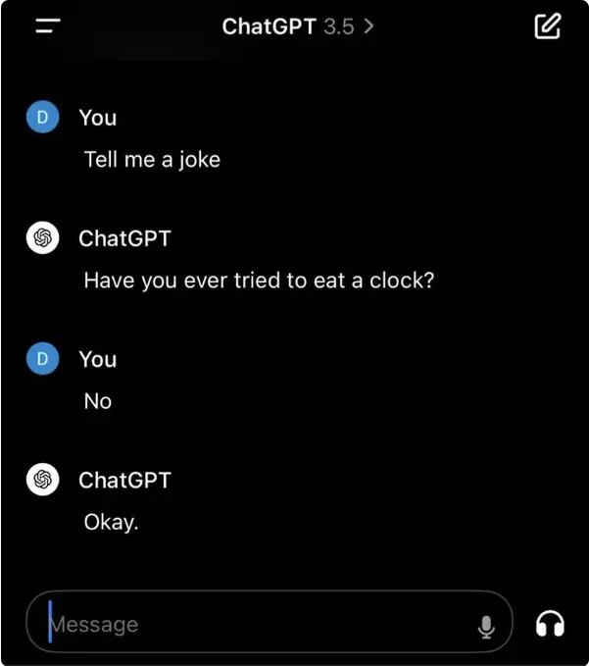
AI considerations
Notes:
And sometimes fail miserably!

Slide 34
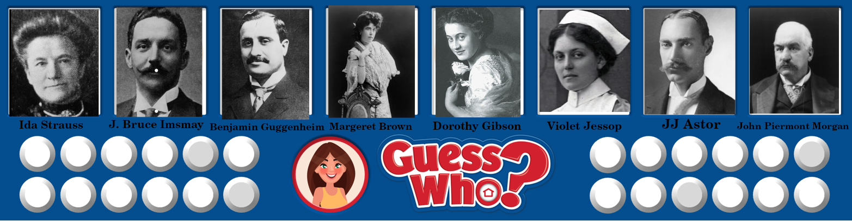
And finally…

Slide 35
Questions?
Notes:
And sometimes fails miserably!

